Slide 2
SNWD_PD – Products
SNWD_TEXTS – Product Language specific texts
SNWD_BPA – Business Partners
SNWD_AD – Business Partner Address
SNWD_SO – Sales orders
SNWD_SO_I – Order items
SNWD_PO – Purchase Order
SNWD_PO_I – PO Items
SNWD_SO_INV_HEAD – invoice header
SNWD_SO_INV_ITEM – Invoice items
https://www.youtube.com/watch?v=1tk4DUOXXQw

Slide 3
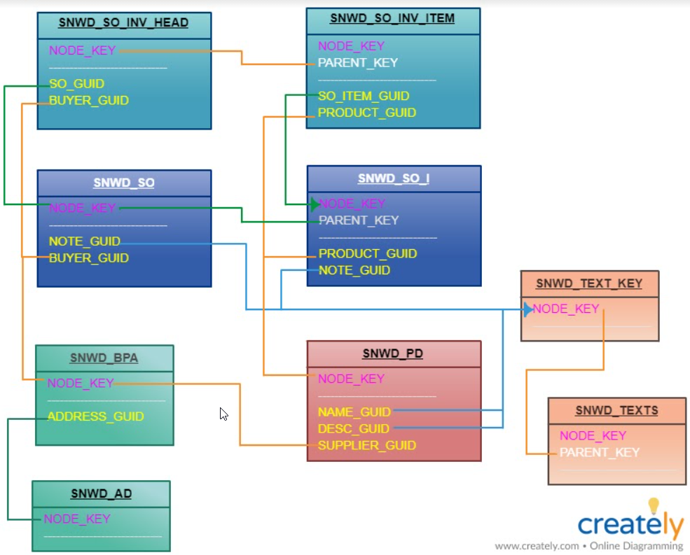

Slide 6
Select * from orders into itab order by amount.
Delete adjacent duplicate itab compare amount.
60
150
250
350
350
800
900
1200
150
60
350
250
1200
900
800
350
Binary

